Slide 1
PROJECT

Slide 2
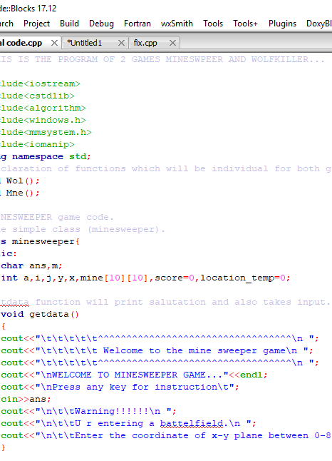
PROJECT INTRODUCTION
Our project has two games
i)MINESWEEPER
ii)WOLFKILLER
2. Now the introduction of games will be carry out.

Slide 3
INTRO FOR MINESWEEPER
Minesweeper is a single-player game.
The objective of a game is to clear a locations contaioing hidden “mines” or bombs without detonating any of them.
The game is originates from the 1960s,and has been written for many computing platforms in use today.

Slide 4
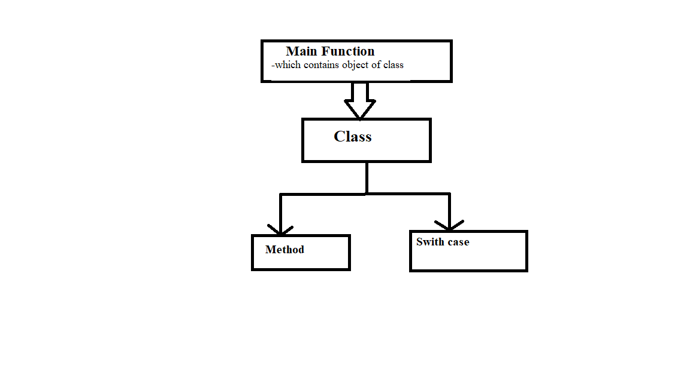
Basic structure of minesweeper game in my program.
The game is made in c++ language which include concepts of class and objects.
It also include switch cases to change the location of mines.

Slide 5
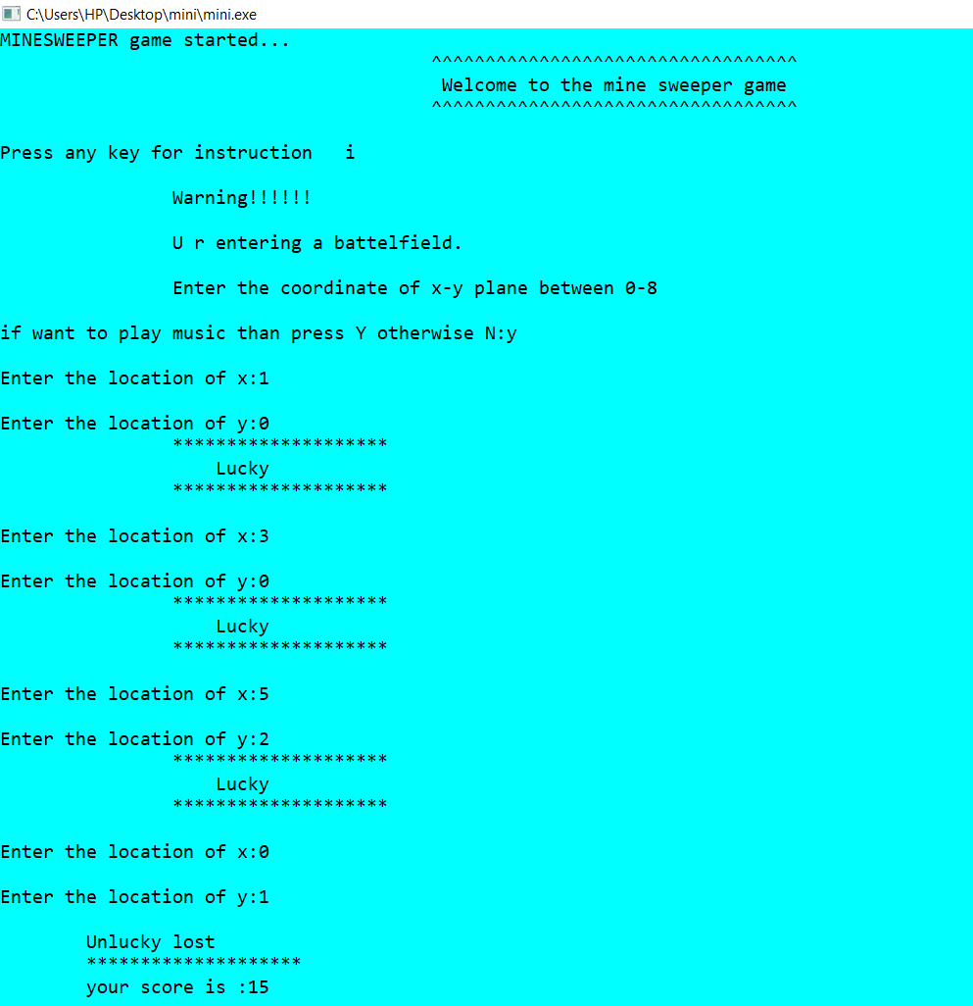
THIS IS HOW WE CAN PLAY THIS GAME!!!

Slide 6
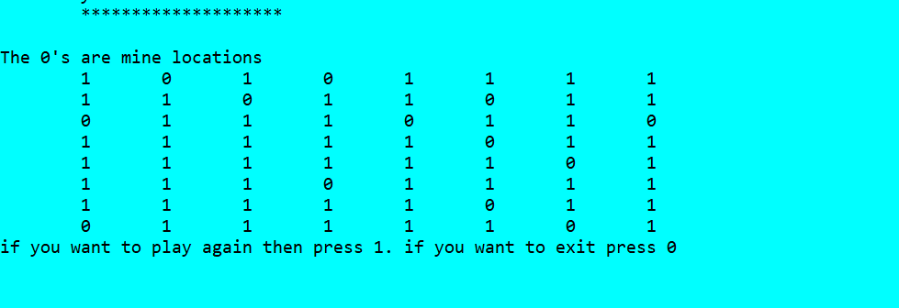
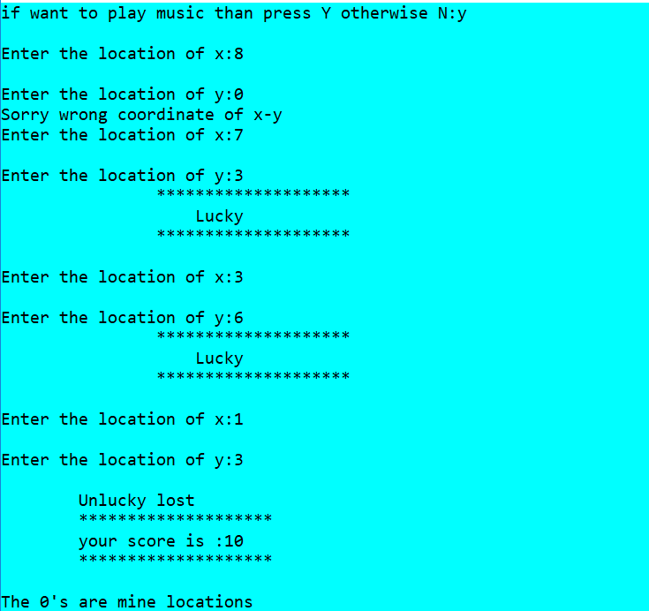

Slide 7
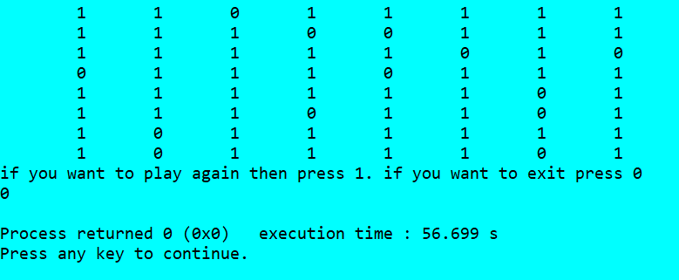

Slide 8
NOW FOR WOLFKILLER GAME

Slide 9
INTRODUCTION TO WOLFKILLER GAME
Now this game is completely new for you.
This game is based on the voting system.
Now ,there are 7 players in this game
From that 7 players
3----> ENEMIES(WOLF)
4----> GOOD TEAM
So the game is divided into 2 parts

Slide 10
The aim of game is to kill those 3 Enemies and win the game
Now to win the game you must have to vote so that the Enemies can die
The player to whom maximum vote get he will die
And he can’t vote in next round
In this way if all the enimies will die then the good team will win else if good team die then the Enemies will win.
So this is how we play the game.

Slide 11
NOW WE WILL SEE HOW THE KILLING THE ENEMY WILL HAPPEN
First when the person will vote by thinking that he is Enemy And if other player also think that he is Enemy then the player get max vote and if in his index the character is “E” then we can say that the Enemy is dead.
And if the character at that place is “G” which indicates that he is from GOOD TEAM but though he got the max vote he will die.
By carrying this process till end and if there remains 2 Enimies and only 1 GOOD TEAM MEMBER then also ENIMIES WILL WIN and if there is situation like there are 2 GOOD TEAM MEMBER and only 1 ENEMY then GOOD TEAM WILL WIN.

Slide 12
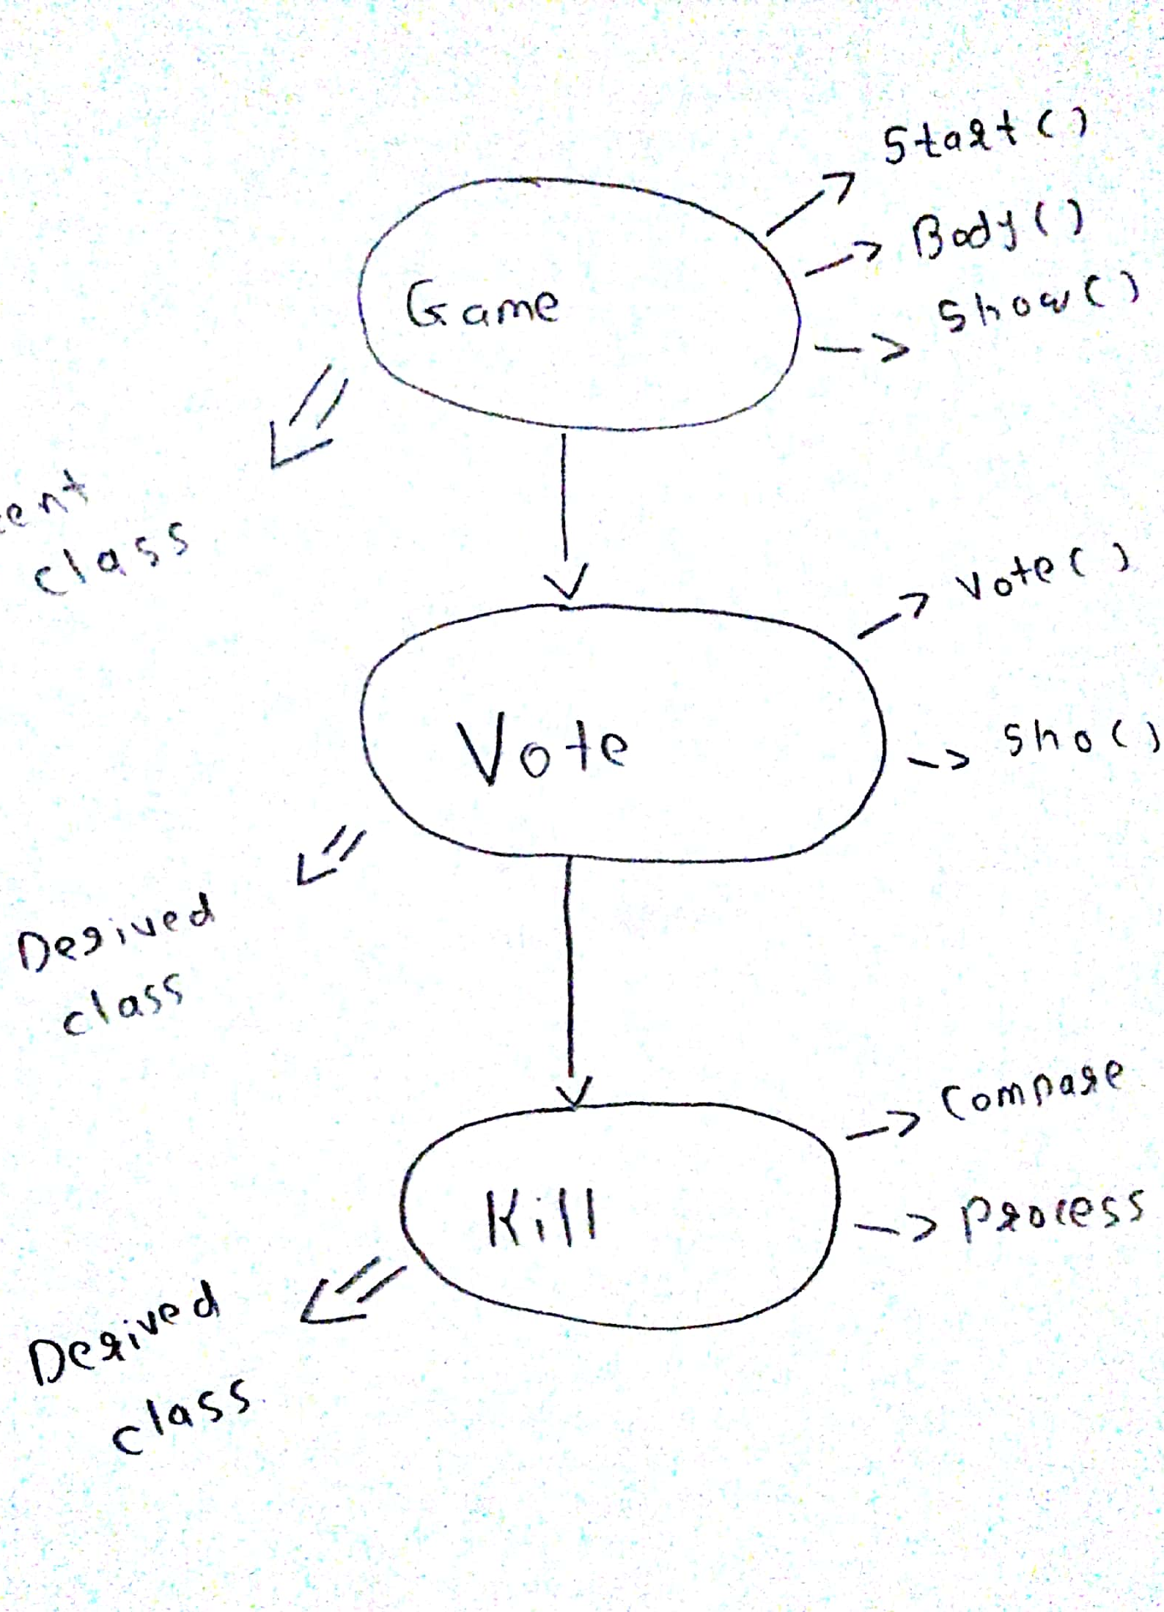
THE BASIC STRUCTURE OF PROGRAM.

Slide 13
THIS IS HOW WE CAN PLAY THIS GAME!!!

Slide 14
EXAMPLE OF GAME

Slide 15
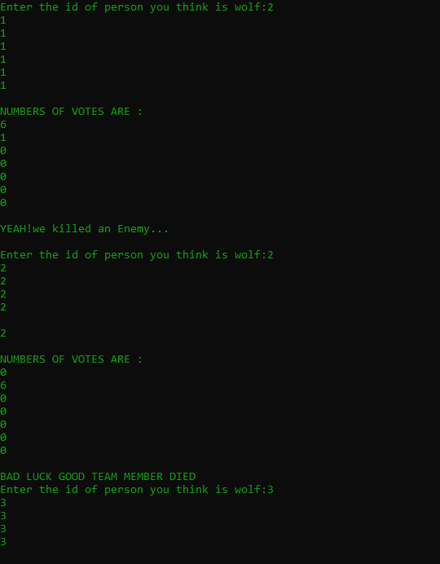

Slide 16
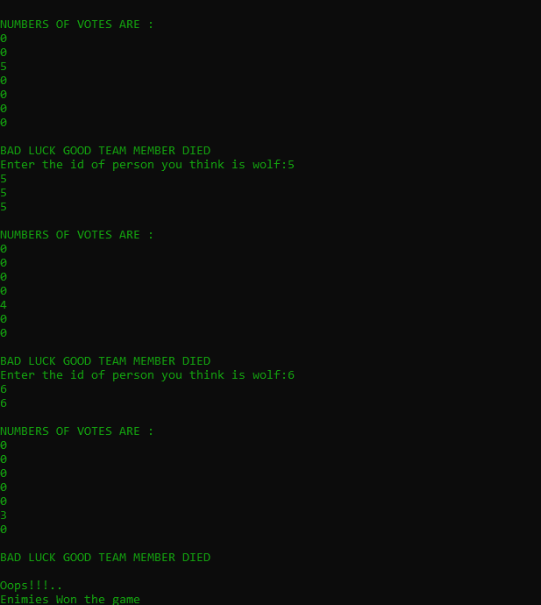

Slide 17
HOW WE CAN WIN EXAMPLE

Slide 18
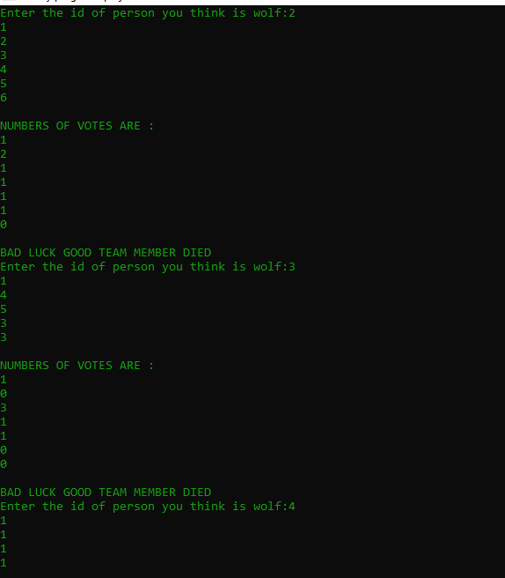

Slide 19
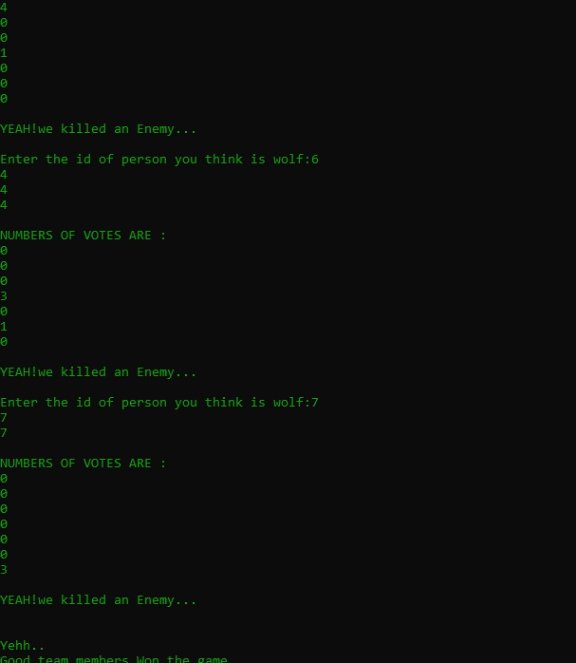

Slide 20
THANK YOU!

